Slide 1
DATA 301:
Prison Sentencing
William Huang and Adam Reay

Slide 2

Research Question:
Can we predict how much time a prisoner will serve in prison based on certain factors?

Slide 3
Step 1: Gathering Data

Slide 4
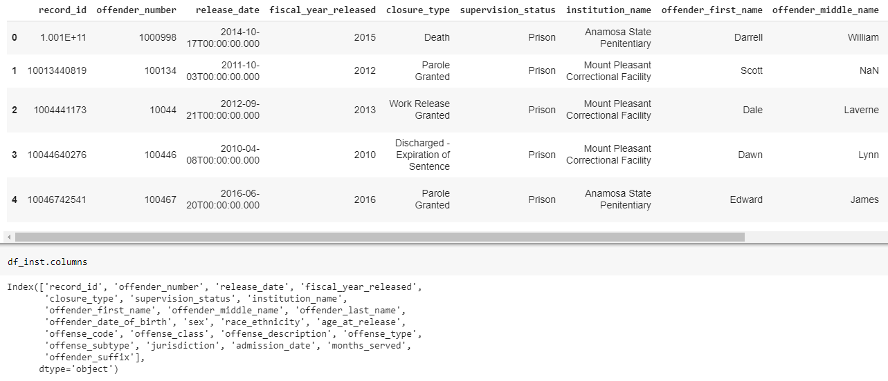
Released Offenders: Iowa Prisons (API /JSON)

Slide 5
Step 2: Cleaning Data

Slide 6
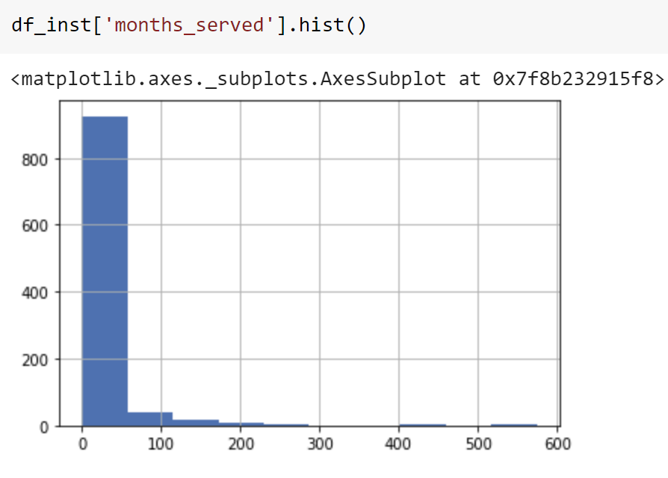
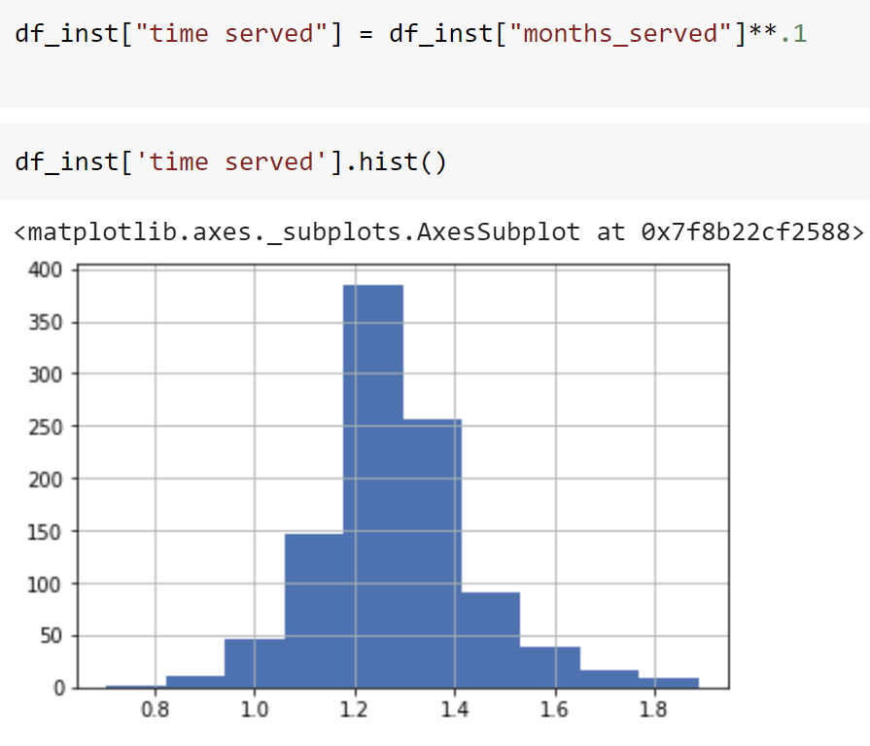
Normalizing Variables

Slide 7
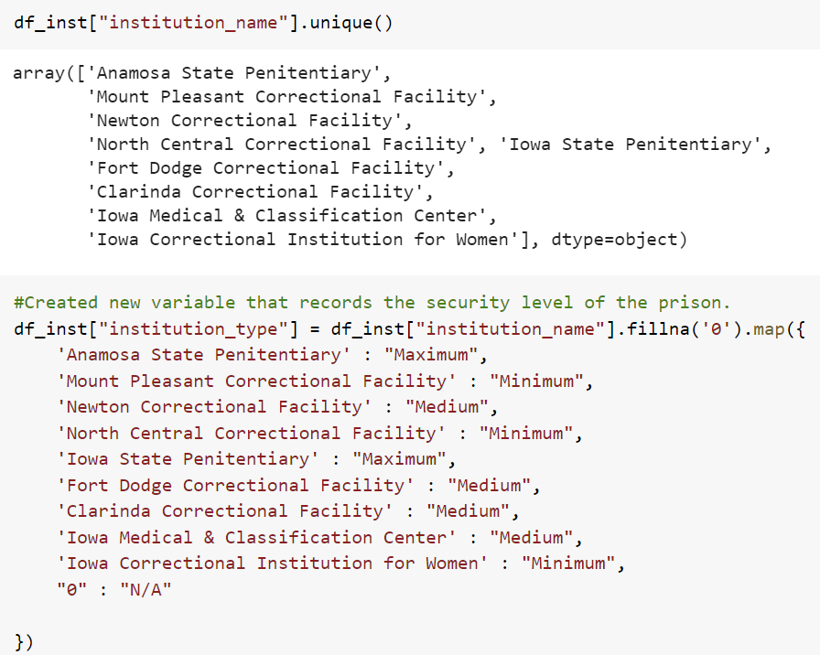
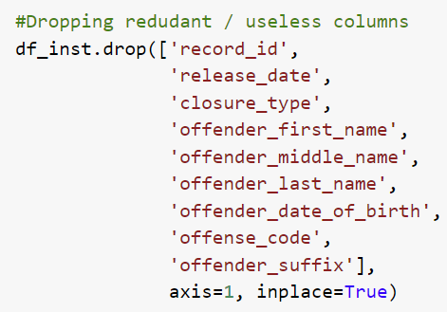
Adjusting Variables

Slide 8
Step 3: Data Visualization

Slide 9
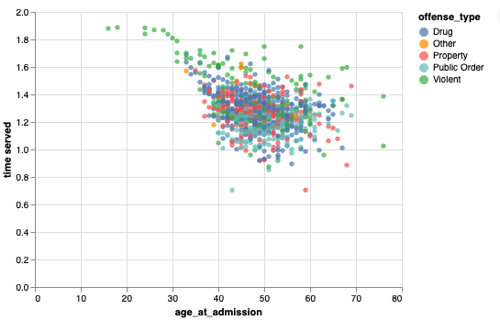
Age of Inmates

Slide 10
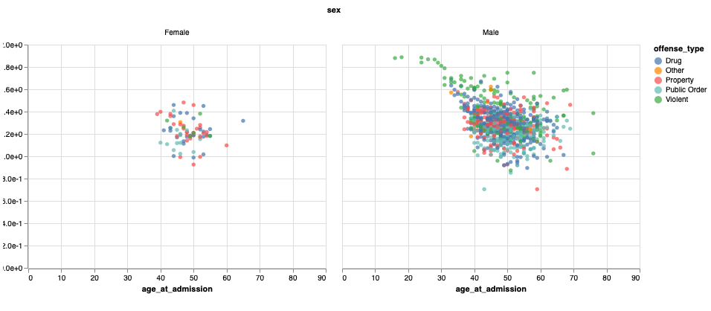
Sex of Inmates

Slide 11
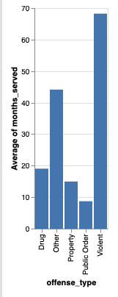
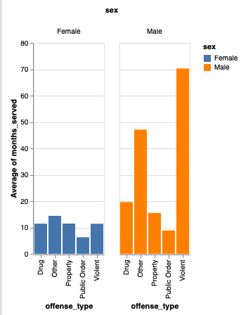
Average Servitude By Offense Type and Sex

Slide 12
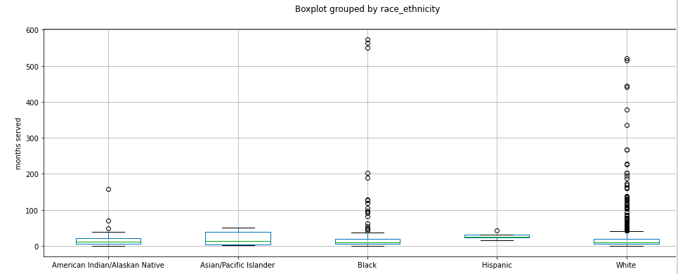
Servitude By Race/Ethnicity

Slide 13
Step 4: Machine Learning

Slide 14
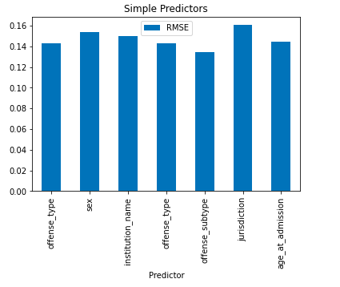

RMSE of Simple Regression Models

Slide 15
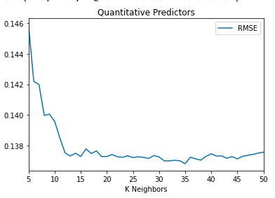

RMSE of Quantitative KNN Models

Slide 16
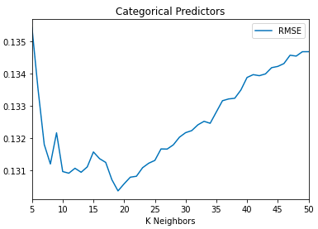

RMSE of Categorical KNN Models

Slide 17
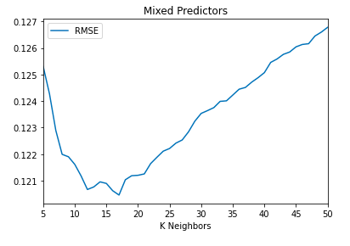
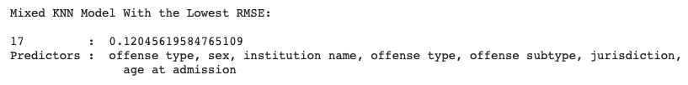
RMSE of Mixed KNN Models

Slide 18
Questions?

